Slide 1
COALS Promotion and Tenure Homerun Series March 5, 2025, 3 PM
This Photo by Unknown Author is licensed under CC BY-NC

Slide 2
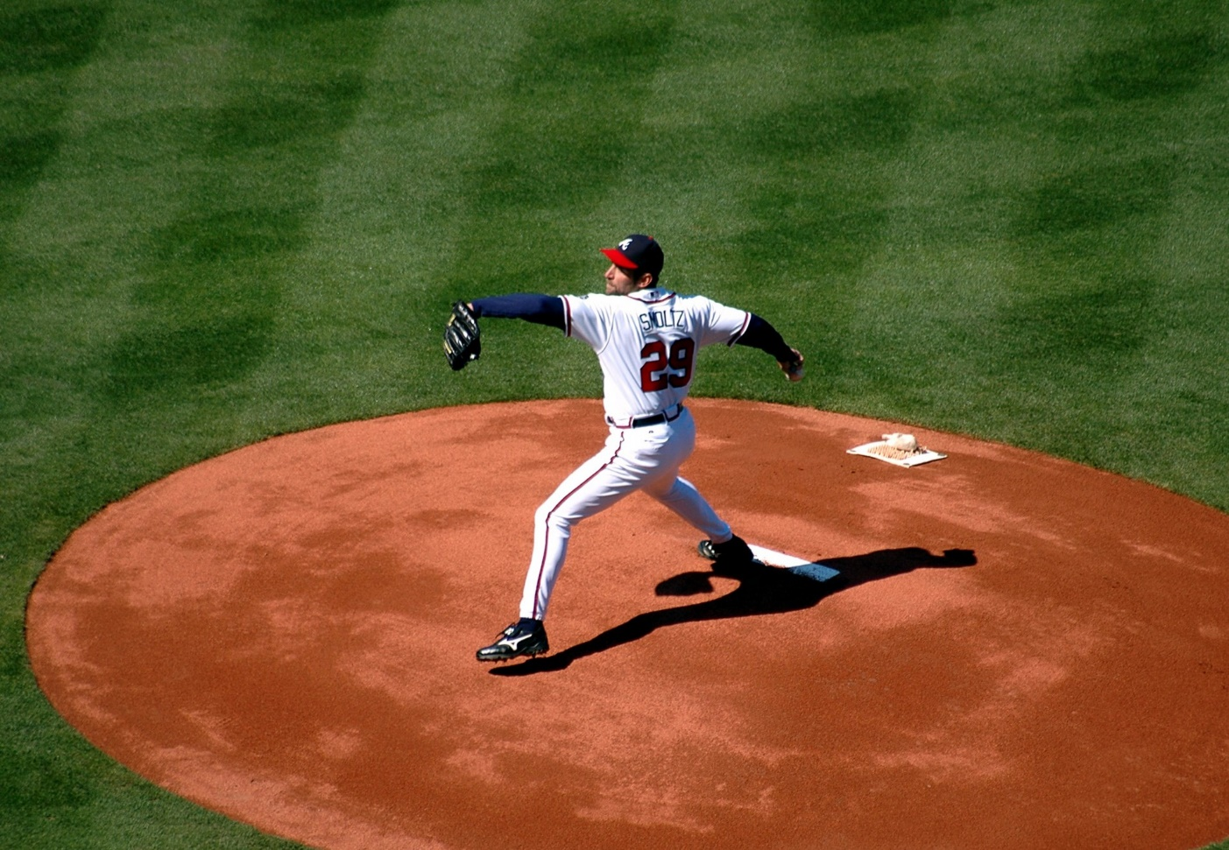
Throwing Out the First Pitch
Policies and Guidelines https://faculty.aglifesciences.tamu.edu/promotion-tenure/
University Policies and Guidelines
University Promotion and Tenure Guidelines
12.01.99.M1 University Statement on Academic Freedom, Responsibility, Tenure and Promotion
College Guidelines
COALS Guidelines for Faculty Evaluation
Departmental Guidelines

Slide 3
1st Base: Take Me Out to the Ballgame
This Photo by Unknown Author is licensed under CC BY-NC
Focus on the Ball: The Essentials
Regardless of your position on the field, we’re all essential for winning the game
Coaching and Communication – continuous mentorship and feedback
You can’t be too prepared; planning is everything
More is not necessarily good; strategy is key

Slide 4
2nd Base: Stealing the Base
It’s all about the impact! Be concise and clear, accurately reflecting your specific contributions
Must use the university’s CV template
Annotate to further articulate your contributions, impact and leadership

Slide 5
3rd Base: Are you Safe? Or Out?
Well-substantiated analysis of the scope (quality, productivity over time, trajectory for the future) based upon percent effort
Teaching: Holistic review of the scope, rigor, and quality of course offerings—moving beyond the student course evaluation; peer evaluation of teaching materials, demonstration of continuous improvement, innovation and adjustments that impact student learning; mentorship and student awards
Research: Include a review of selected publications to demonstrate impact on the discipline and establishment of national/international reputation; independence through external funding and support/co-authorship with graduate students and impact on the profession
Service: Quality and impact; seen as a leader in the discipline

Slide 6
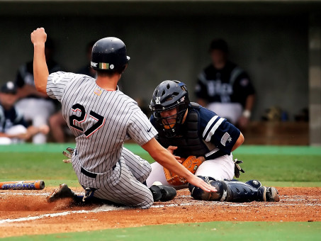
Homerun! We must score to win
Play Ball!

Slide 7
Strikes
The impact statement should have an overview in the first paragraph in layperson terms
Don’t “pad” the dossier
Don’t include student awards or your award nominations in your awards section
Majority of external reviewers from AAU and Peer Institutions, must justify if not
Once the dossier goes out for external review, it cannot be changed except through addendum (substantive additions or changes)

Slide 8
Changes on the University Guidelines
More clarity, checklists and examples. Oh My!
The CV Template has added a section for Administrator Appointments
You may add a summary table of grants (the old table)
Keep in mind that you’ll need to use your tamu email to access the FA Sharepoint
Emphasis on Impact Statements, Biography Template, too much redundancy
Limit Supplemental Documentation; keep at department level (analyze for report)
Annotate to show the relevance

Slide 9
Other Discussion Topics Provided
Interfolio Interface for Providing Content for CV Template: The CV template was designed to be downloaded from Interfolio 180. It doesn’t work very well, so best to take the information from Interfolio and paste into the CV Template.
Library Sessions on Demonstrating Research Impact
o Wednesday, March 19, 12:00-1:00 p.m.
o Wednesday, April 2, 11:00-12:00 p.m.
Annotated CV Format and Dossier Preparation: Promotion & Tenure - COALS Faculty Affairs and Workshops!
Evidence for Excellence: See Guidelines Section 4 - place into disciplinary context
Mid-term – College Steps and Expectations: (TT) Peer evaluation of teaching materials, trajectory of research independence, mentoring graduate students, extramural funding; (APT) Peer evaluation of teaching materials, Teaching CV is a good format to provide evidence of teaching excellence and impact. APT does not have a mandated timeline but 3 years for midterm is common.
Building a National and International Reputation: Invited Speaker, Citations, Editorial Boards, National/Prestigious Awards, Leader in Discipline, (required for promotion to full)

Slide 10
How do we simplify the process and reduce the amount of time spent on these materials?
This Photo by Unknown Author is licensed under CC BY-ND
Notes:
Begin at the beginning! Be strategic. Think about evidence and impact in research and teaching.
Have a mentoring committee. Check materials in Interfolio 180 for accuracy. Use your annual performance review as formative feedback. Look at materials for someone who recently was promotion.

Slide 11
Q & A Play Ball!

