Slide 1
COALS Faculty Dossier Preparation Workshop: Getting Your Bases Loaded March 21, 2025, 3 - 4 PM
This Photo by Unknown Author is licensed under CC BY-NC

Slide 2
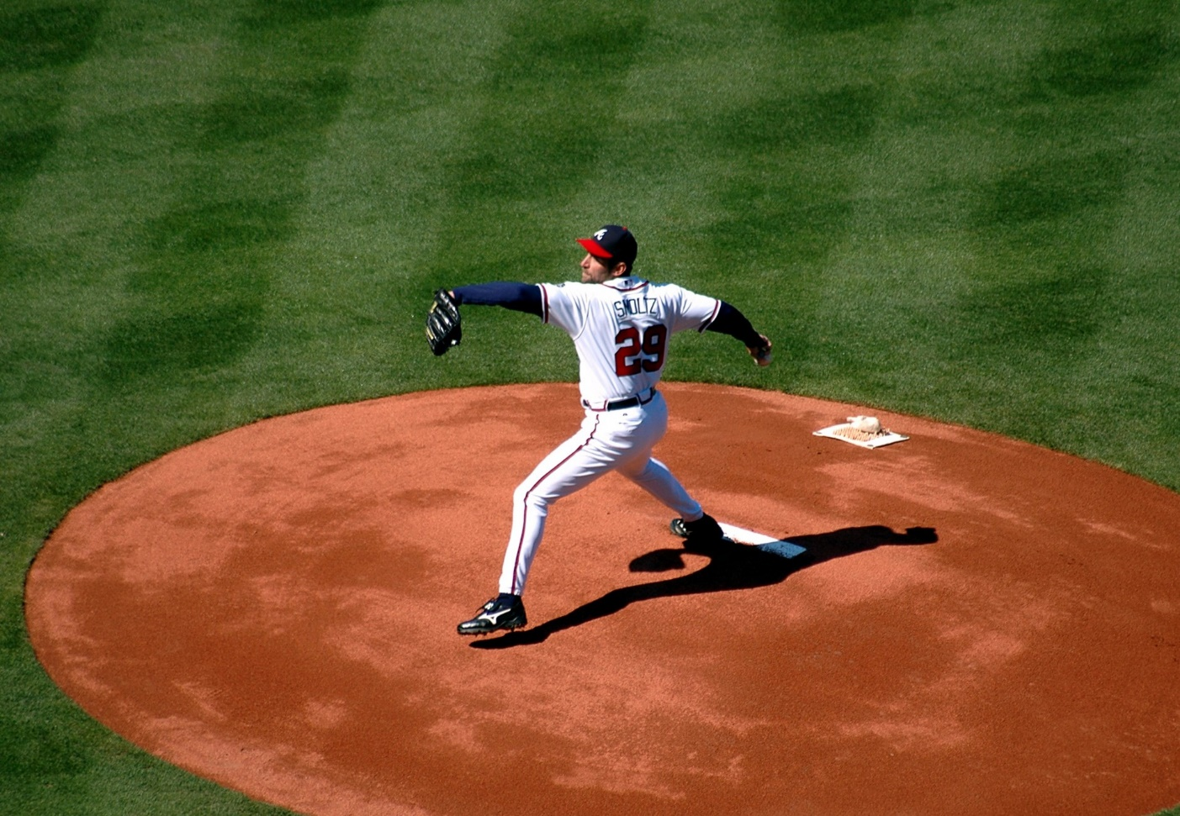
Throwing Out the First Pitch
Policies and Guidelines https://faculty.aglifesciences.tamu.edu/promotion-tenure/
University Policies and Guidelines
University Promotion and Tenure Guidelines
12.01.99.M1 University Statement on Academic Freedom, Responsibility, Tenure and Promotion
College Guidelines
COALS Guidelines for Faculty Evaluation
Departmental Guidelines

Slide 3
1st Base: Your Dossier
This Photo by Unknown Author is licensed under CC BY-NC
Impact Statement (3 pages)
Provide your perspective/narrative on the impact and the context for the review of the entire case
The first paragraph is an overview in lay-person terms
State your percent appointment and address each area of responsibility in proportion
Include past accomplishments and evidence of impact, present activities, and future trajectory in each area of responsibility
See examples of evidence for contributions in TAMU P&T guidelines
Ensure the statement is well-reasoned, well-elaborated, and well-written; it should be jargon free, enlightening and exciting
Get feedback from department head and mentors before final submission
Come to the Workshop on Impact on Friday, April 4

Slide 4
2nd Base: Your Dossier
Annotated CV
Concise and clear, and accurately reflect your specific contributions
Must use the university’s CV template and do not alter the headings/order
Specify authorship protocols of the discipline
Use the template for the grants chart
Include a 200‐word biography in third person (see examples for how to start-required)
Annotate your CV to further articulate your contributions, impact and leadership

Slide 5
3rd Base: Your Dossier
Other Materials and Documentation
Materials that are deemed pertinent to the case, but not appropriate for placement elsewhere—do not overuse.
Departmental guidelines may require certain documents to be included in this section (teaching materials, selected publications, etc.); these are for the departmental report and external reviewers.
More it not better. Think of this as a grant RFP. Make it easy for the committee to find the relevant information.
Upload documents to Interfolio, Supplemental Document Section or submit to department (check with department)

Slide 6
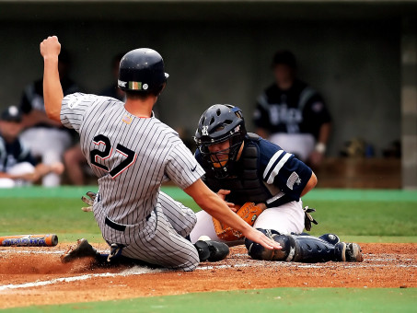
Homerun: External Reviewers
Checklist of potential external reviewers (for tenure-track and research faculty only)
Recognized leaders in the discipline who are qualified to speak with authority about your accomplishments, future trajectory, and impact to the field (see checklist).
At least 5 from peer or aspirational universities (go for 7-10) (AAU and additional peers approved for college), or at top academic programs from other institutions, or preeminent experts from non‐academic institutions (with justifications on program ranking and expertise credentials, cannot be the majority). If unsure, submit to us prior to contact.
Arm’s length - not graduate or postdoctoral advisor, collaborator or coworker (last 5 years), business or professional partner, or any family member/relative.
Candidate can submit a “do not contact” list.
For APT, can include letters that are evaluative, but do not need to be external or arms-length. Please limit the number of letters to 5 to not overburden the reviewers.

Slide 7
Research Expectations for Promotion
Expected to demonstrate excellence in research
Assistant to Associate: independence in scholarship, meaningful impact in their field, and being recognized as leaders in their field or on a strong and sustained trajectory to attain national leadership status
Associate to Full: be recognized leaders nationally, and for many fields internationally, and demonstrate impact that has advanced their field; leader in profession
Demonstrate your impact that has advanced the field
Clearly define your “field” of research and its relevance, value and impact for the department, TAMU/TAMUS, the state of Texas, the nation and the world
Provide specific examples where you have advanced the field forward nationally and internationally, and associated recognitions
This Photo by Unknown Author is licensed under CC BY-SA

Slide 8
Research - Evaluation
How the candidate has defined, developed and positioned their scholarship and field of study throughout their career to achieve impact
Evidence of leadership and impact in their field of research compares favorably to those typical of leaders in their field
Success in securing competitive extramural funding from federal, private and corporate funders
Number, quality and impact of publications in leading journals accessible to leaders in the field
Prestigious external awards and seminar invitations
Number of citations and, where applicable, translational impacts
Peer evaluation letters from leaders in the same or closely related field from leading academic institutions
Analysis of the content of candidate’s work and how it has affected the field, by external reviewers, P&T committee, and department head
This Photo by Unknown Author is licensed under CC BY-SA

Slide 9
Teaching Expectations for Promotion
Potential evidence for demonstrating teaching excellence/effectiveness
Evidence generated by peer evaluation of teaching materials (syllabus, assignments, examinations, and grading methods) with a summary provided in the departmental teaching report. Best practice includes classroom observations.
Student teaching evaluations, Experimentation with and use of pedagogical approaches to improve student learning and success.
Quality and quantity of trainee-authored publications, awards, job placements, time to degree, etc.
Responsiveness to student and peer evaluations (reflections and efforts to improve)
Publication of instructional materials
Professional development in teaching and associated improvements
This Photo by Unknown Author is licensed under CC BY-SA

Slide 10
Teaching - Evaluation
Evaluation of course materials (e.g., course syllabi, assignments, examinations, and grading methods), as part of the determination of the scope, rigor, and quality of the candidate’s course offerings is required.
Synthetic analysis of student evaluations of teaching (department provides)
Evaluation of other valuable teaching contributions to the department, such as the mentoring of undergraduate and graduate students and post‐docs, participation in student development programs, curriculum development, development of new courses or substantial revision of existing courses, textbook and other instructional materials, participation in honors programs, implementation of high impact learning activities, awards or recognition for distinguished teaching, and other teaching related activities
Evaluation of teaching should focus on the quality of the contributions and the impact, be consistent with standards established by the guidelines, and place the candidate’s impact in the context of the departmental mission, goals, expectations and criteria
This Photo by Unknown Author is licensed under CC BY-SA

Slide 11
Service
Expectations for promotion
A commitment to service is an expectation of all faculty with service assignment
Include service within the institution and externally
Leadership and impact of service (especially external) should grow throughout the career of the candidate
Service evaluation:
How the service activities contribute to national and international reputation and recognition for the candidate and Texas A&M
How the impact of service contributions relate to ongoing or emerging needs of the department, institution and profession
This Photo by Unknown Author is licensed under CC BY-SA

Slide 12
How to know it’s ready to submit?
Review based upon departmental, college and university guidelines.
Have your mentoring committee review and provide feedback.
Have the chair and/or department head review before uploading AND before it is sent to the external reviewers.
For TT, the department will ask for examples of your most impactful research articles. These are used by external reviewers and the departmental committee to write reports.
Make sure the external reviewers are majority from the department list and from AAU or Peer Aspirant; this should be approved before sent and must provide a strong justification if not.
Have the department provide your synthetic teaching table based upon departmental questions and comparisons.

Slide 13
Q & A Let’s Play Ball!

