Slide 1
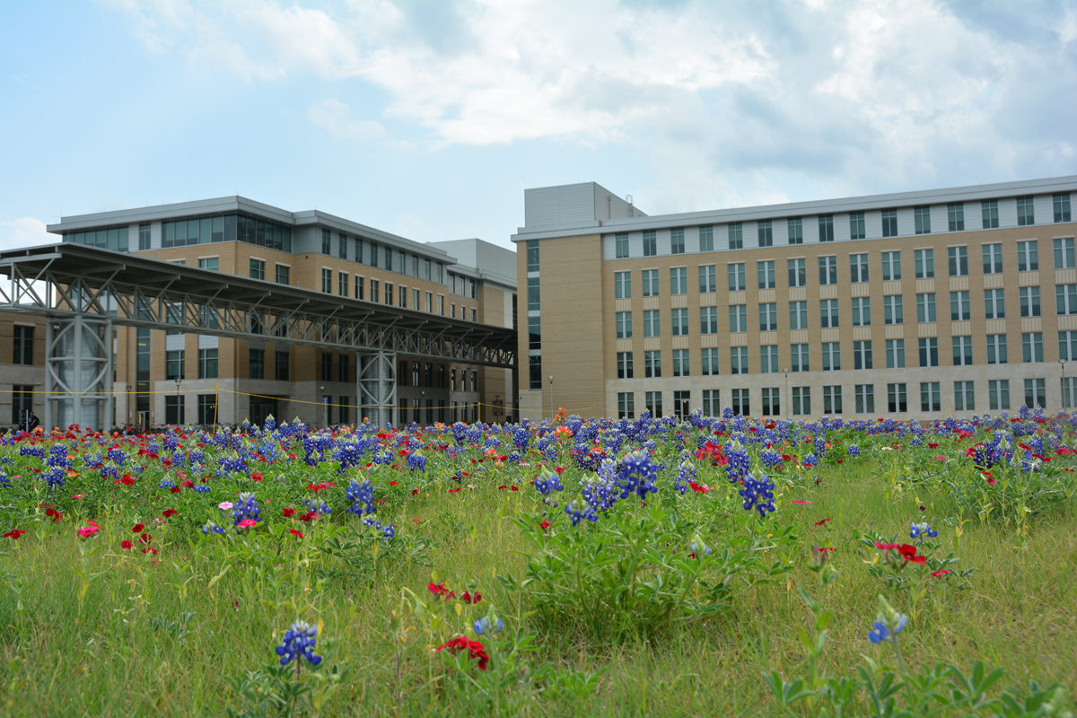
AgriLife Research & Extension Service Faculty Dossier Preparation Workshop
For AgriLife Research and Extension
faculty preparing dossiers for submission
February 7, 2025
Microsoft Teams:
Dan Hale and Amir Ibrahim

Slide 2
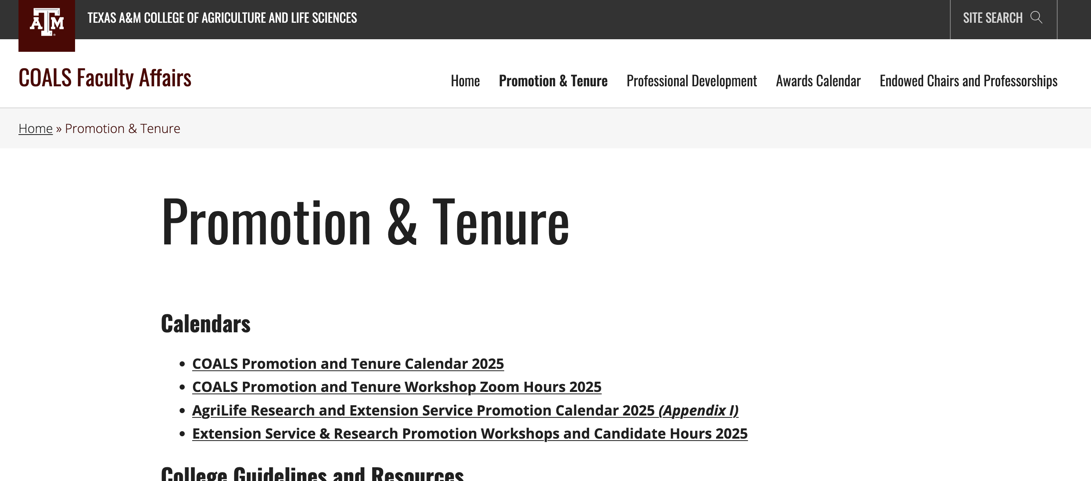
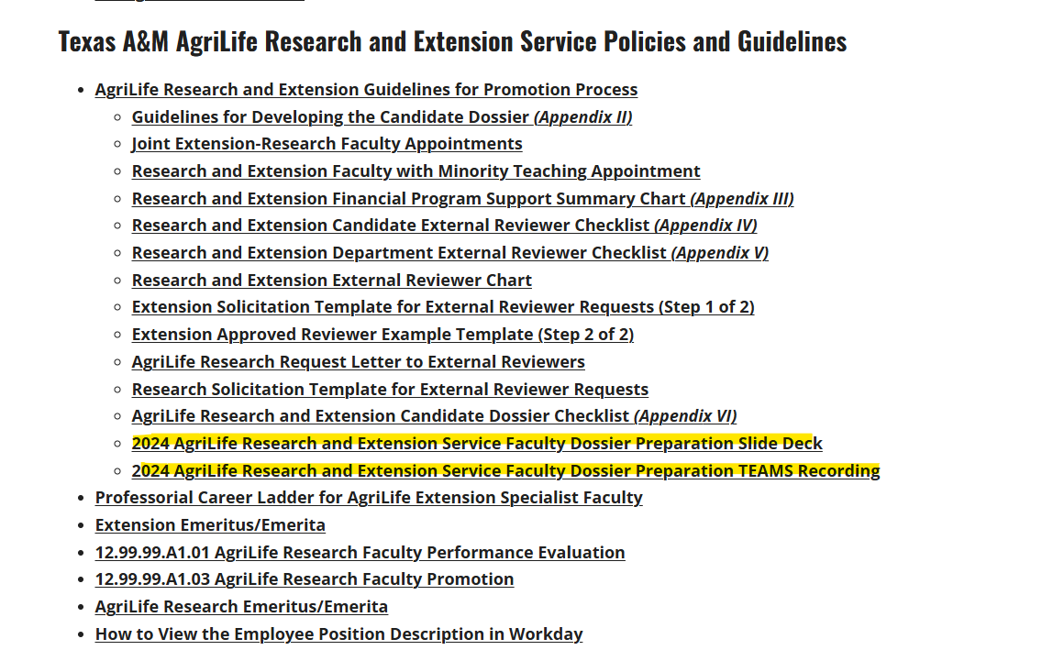
https://coalsfaculty.wpenginepowered.com/promotion-tenure/

Slide 3
Agenda
Position Description
Mentoring Committee
Promotion Process for Extension and for Joint Appointments
Candidate Dossier and Impact Statement
Program Support Chart
External Review Letters
Promotion Committee Make-up
Extension Specific Guidelines
Research Specific Guidelines
Extension and Research Faculty with Teaching Responsibilities
Questions

Slide 4
Position Description
Position Description
Serves as the document of record (baseline) used by committee members, external reviewers, and supervisors to evaluate the accomplishments and impacts of the candidate.
Needs to be current & accurately reflect the duties and responsibilities of the candidate
Should be revised and agreed to during the annual performance evaluation

Slide 5
Mentoring Committee
Contributes to the success of new faculty members, supervisor(s) will provide guidance on suitable faculty mentors.
Responsibilities of the mentoring committee include:
Assists the candidate in developing their dossier for their Mid-Term Review (described below) and for promotion
Assists the candidate in developing a list of potential external reviewers that may evaluate the faculty member during candidacy for promotion
The chair of the mentoring committee should be an Extension faculty member for Extension ad loc. faculty and be a Research faculty member for Research ad loc.
Faculty should have a rank higher than the mentee. Committee members can consist of faculty members from other Departments/Centers/Units as deemed appropriate, including tenured or tenure-track faculty
Documentation of the status of the faculty member’s performance recommendations are presented to the supervisor(s) annually, until the faculty member successfully moves to the rank of associate professor.

Slide 6
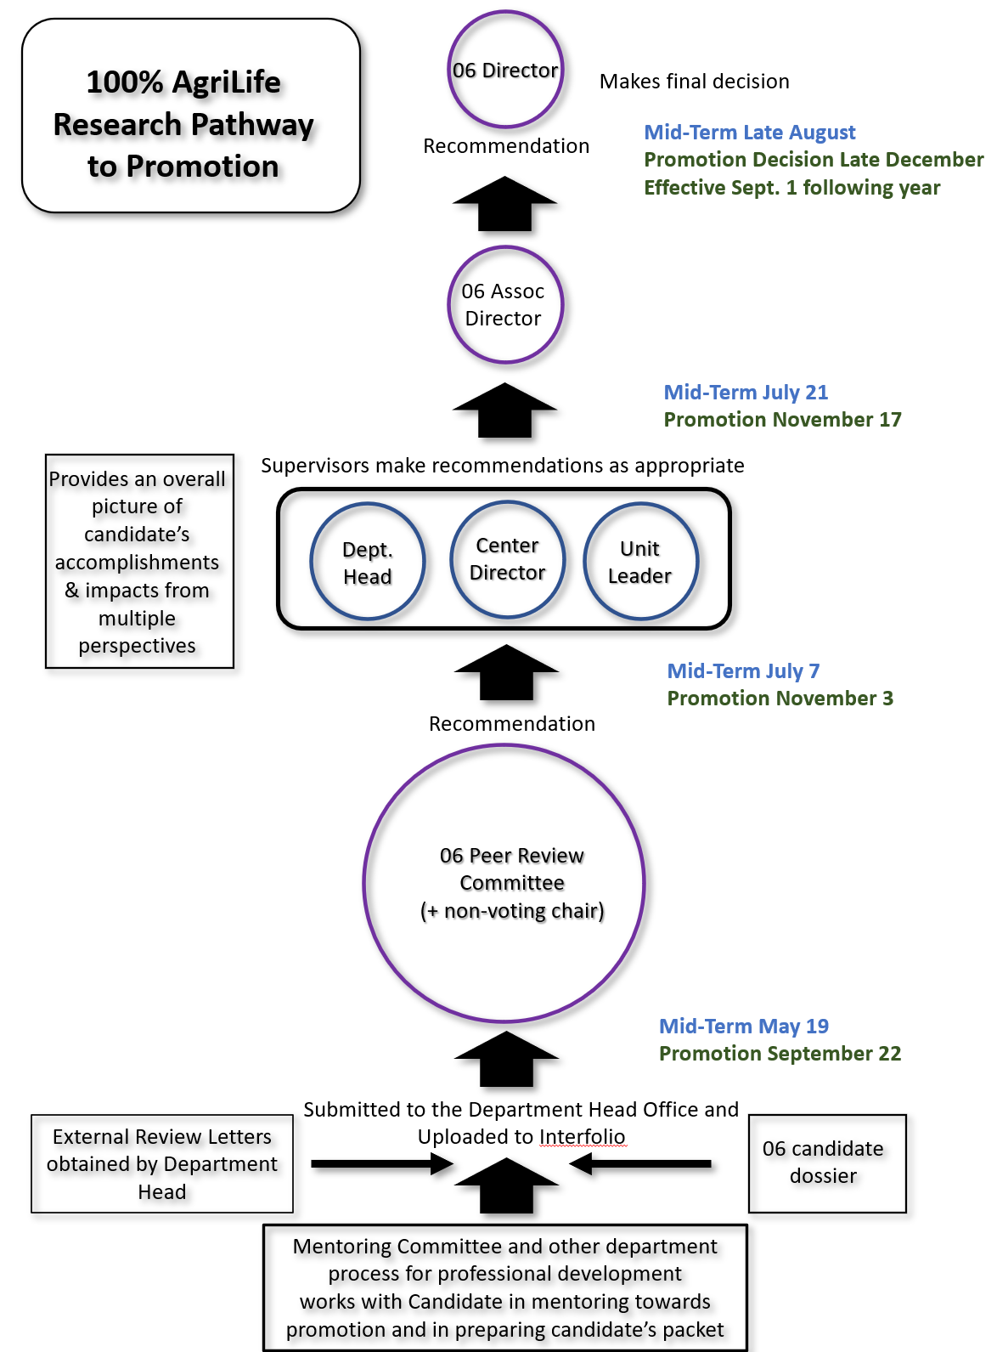
Mid-Term: Late August
100% AgriLife Research
Pathway to Promotion
Promotion Decision: late December, effective Sept. 1 following year
Mid-Term: July
Promotion: November
Promotion Process:
Mid-Term: July
Promotion: November
Mid-Term: May
Promotion: September

Slide 7
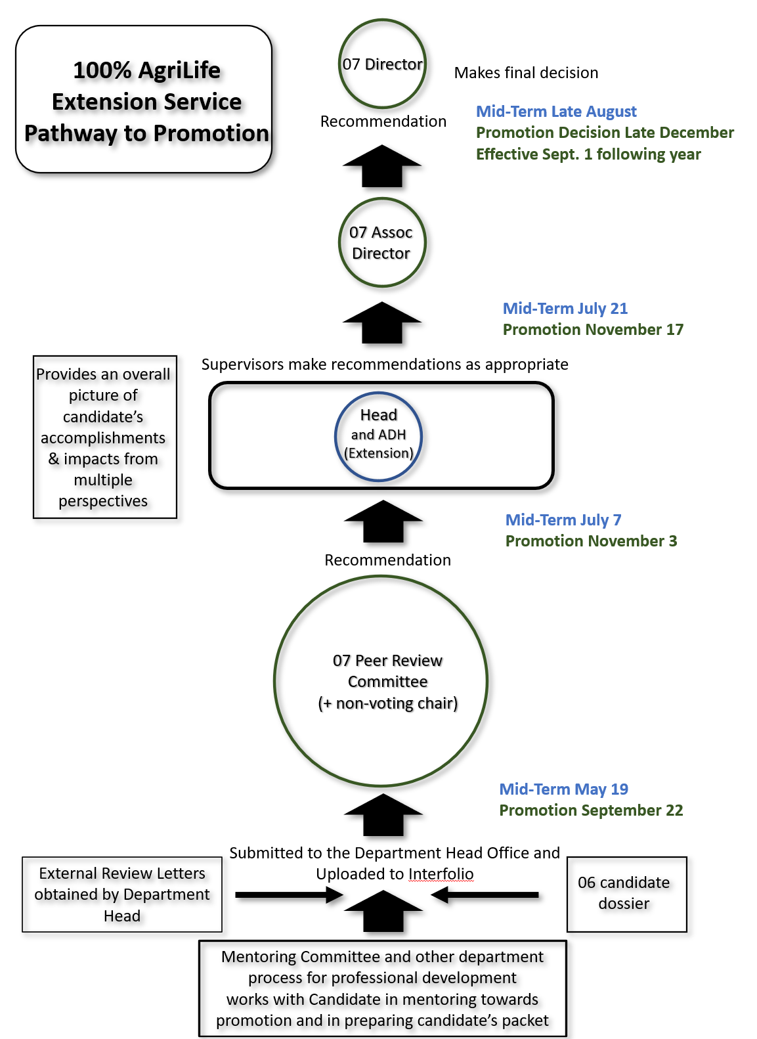
Mid-Term: Late August
Promotion Decision: late December, effective Sept. 1 following year
100% AgriLife Extension Service Pathway to Promotion
Mid-Term: July
Promotion: November
Promotion Process:
Mid-Term: July
Promotion: November
Mid-Term: May
Promotion: September

Slide 8
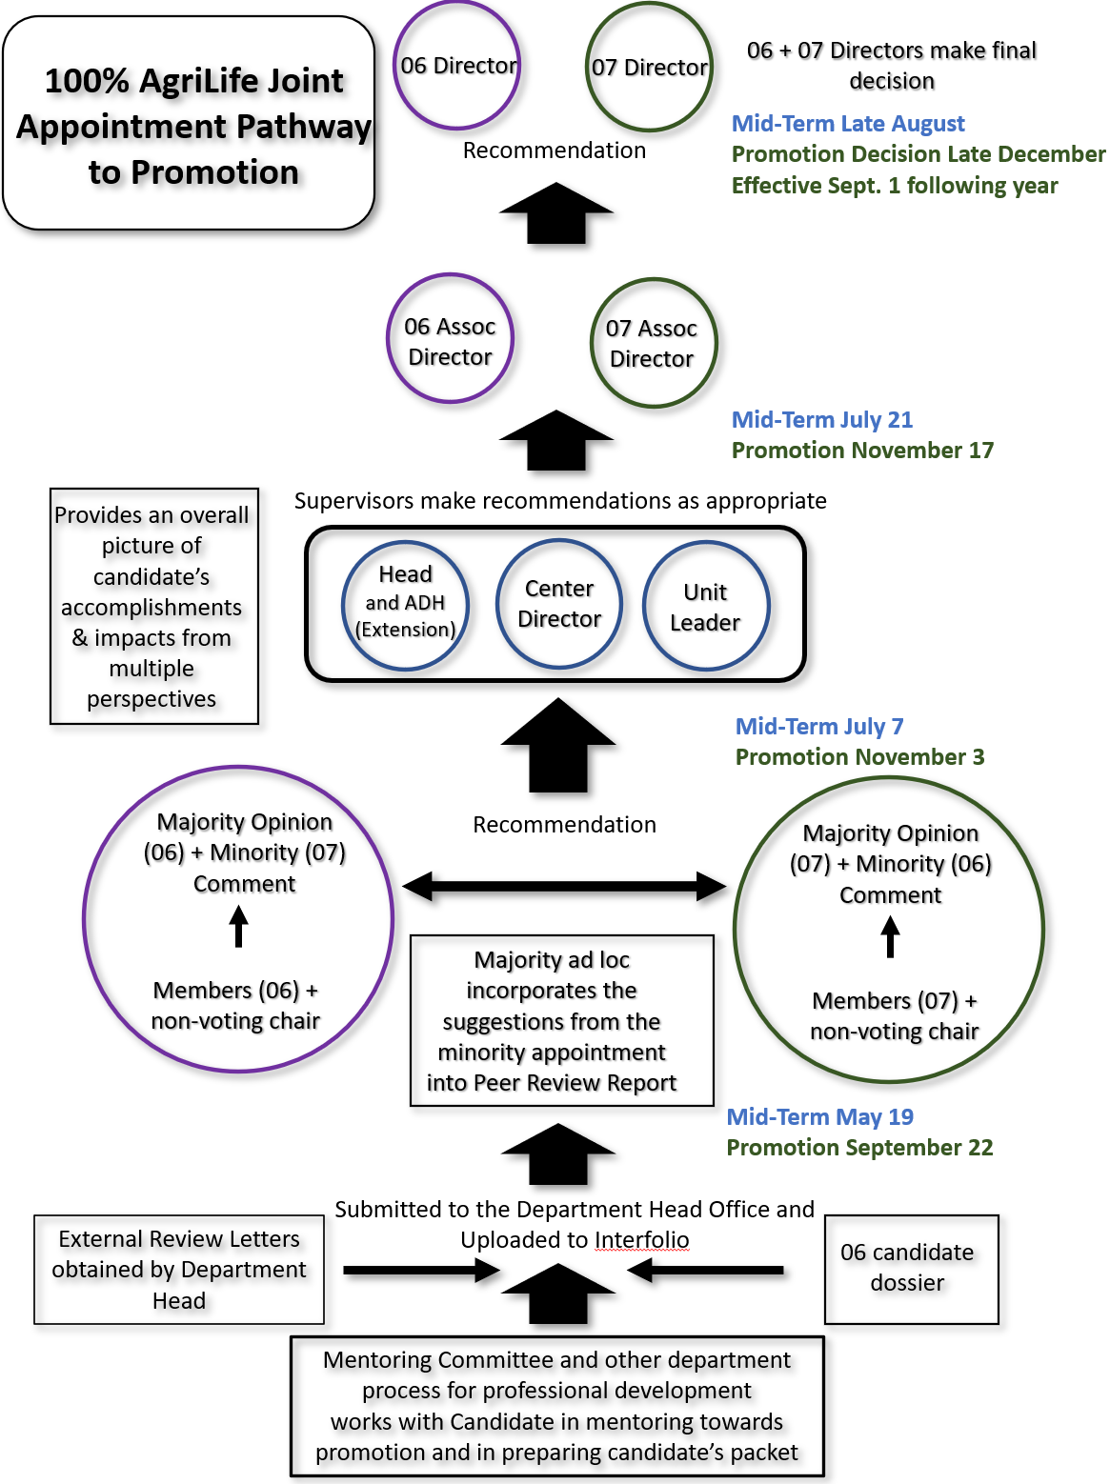
Mid-Term: Late August
Promotion Decision: late December, effective Sept. 1 following year
Joint AgriLife Research/Extension Service
Pathway to Promotion
Mid-Term: July
Promotion: November
Mid-Term: July
Promotion Process:
Promotion: November
Mid-Term: May
Promotion: September

Slide 9
Your Dossier: Appendix II
This is based on the requirements set by your department or center
Position Description
1st document in dossier
3-Page Summary
2nd document in dossier
Serves as the narrative to complement your CV, not a reiteration
Explains how you translated your philosophies in Research, Teaching and Service/Outreach into impacts on local, state, national and international groups
For 100% Research appointment: Teaching usually involves graduate/post-doctoral mentoring
Annotated CV
3rd document in dossier
Demographic information (education, years in current rank, location, appointment)
Under funding, publications—include 1-2 sentences why your contribution essential (see →)

Slide 10
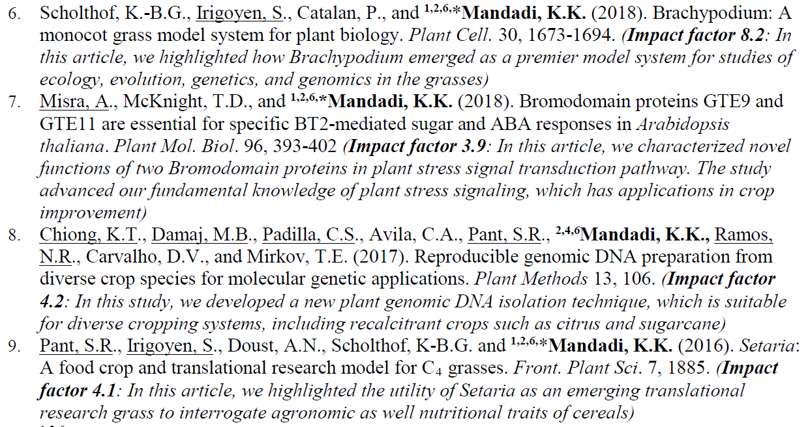
An example of annotation

Slide 11
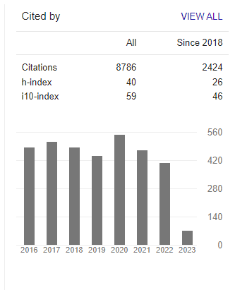
Example of a Publication Table in CV
Journal Impact Factor
Nature Biotechnology 68.16
Annu. Rev. Plant Pathology 10.9
Curr. Opinion Plant Biology 9.39
Plant Physiology 8.01
Front. Plant Sciences 6.63
PLoS Genetics 6.02
J. Molecular Biology 5.47
Appl. Environ. Microbiology 5.01
Environ. Microbiology 4.93
J. Natural Products 4.80
BMC Genomics 4.56
Microbial Ecology 4.20
Front Microbiology 4.08
Phytopathology 4.01
PLoS One 3.75
Appl. Environ. Biotechnology 3.53
J. Bacteriology 3.49
J. Antibiotics 3.42
Mol. Plant-Mic. Interactions. 3.34
Microbiology 2.96
FEMS Microbiol. Letters 2.74
European. J. Plant Pathology 2.02
https://scholar.google.com/

Slide 12
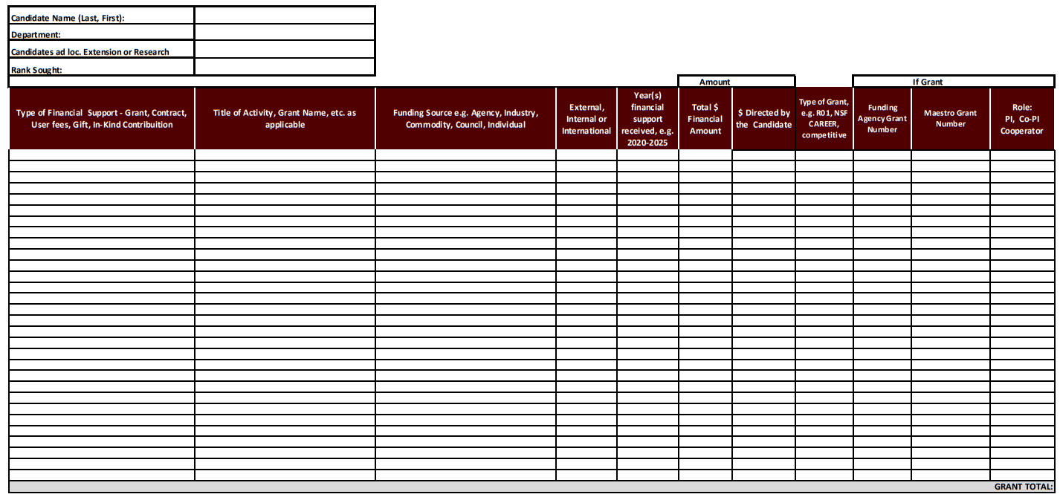
Your Dossier: Appendix III
Summary Chart for Grants & Other Sources of Funding

Slide 13
Other Materials and Documentation
Specific departments may require other documents to be included in this section. See your specific departmental guidelines for more details
External Reviewer Checklist (Appendices IV & V)
Candidate submits to DH or ADH a list of potential external reviewers
DH and/or ADH develops own list of potential reviewers
Must be ‘arms-length’
5 years since collaboration or co-authorship
Not a co-worker in past 5 years
Not a business or professional partner
Not a thesis, dissertation or post-doc advisor
Not a family member (including relatives)
From a peer or aspirational institution
Holds academic rank higher than candidate
Not from “Do not contact list”
√
√
√
√
√
√
√
√

Slide 14
Research/Extension- Expectations: (Promotion to associate)
Scholarship
Demonstrate independence in scholarship
Collaborative work is encouraged; but emphasize your major and independent contributions
Impact
Demonstrate meaningful & nationally recognized impact in your field of research
Leadership
Be recognized as a leader in your field of study, or be on a strong and sustained trajectory to attain national leadership status
Statewide and regional (multi-state) leadership should be addressed

Slide 15
Research/Extension- Expectations: (Promotion to Full Professor)
Leadership
Evidence of recognition as a leader regionally and nationally
Impact
Demonstrated impact that has advanced the field
Define the “field” of research and its relevance, value and impact for the unit, agency/TAMUS, the state of Texas, and the nation
Provide specific examples where you have advanced the field
Growth
Leadership and impact in a field should grow and broaden in scope throughout the career of the candidate.

Slide 16
Research/Extension Evaluation
Your position description is key!!
1
How the candidate has defined, developed, and positioned their scholarship and field of study throughout their career to achieve impact
Excellence in research, extension, productivity, and impact
Extramural funding from federal, private, corporate, public funders
Number, quality, and impact of publications/bulletins in high impact avenues
Translational impacts
External awards and invited talks
Regional/national/international recognition of the program
2

Slide 17
Teaching: (Academic and Student Mentoring)
Appropriate based on position description/duties
Mentoring graduate students and postdocs
Demonstrate the impact through student outcomes (presentations, publications, grants, awards, placements, etc.)
Classroom/online teaching (if applicable)
For AgriLife Research faculty with a joint appointment at a regional university, document teaching but evaluation will be done through a separate process

Slide 18
Service/Outreach
Service within the agency/institution and externally
Effective outreach with stakeholders
Document how service activities contribute to regional and national reputation and recognition for self and Texas A&M AgriLife
Leadership and impact of external service should grow throughout the career of the candidate

Slide 21
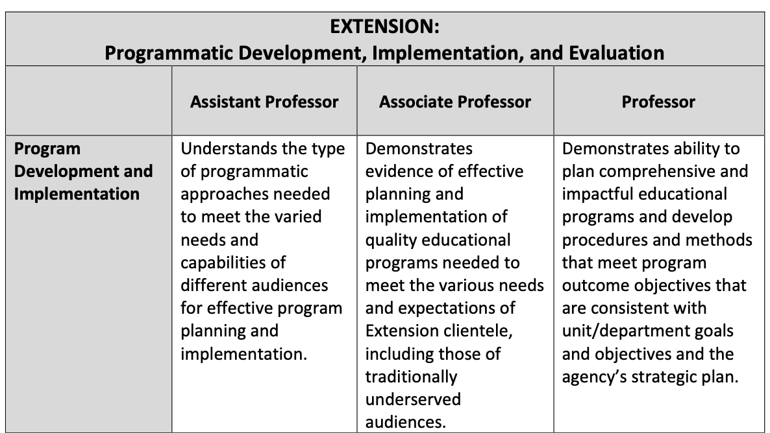
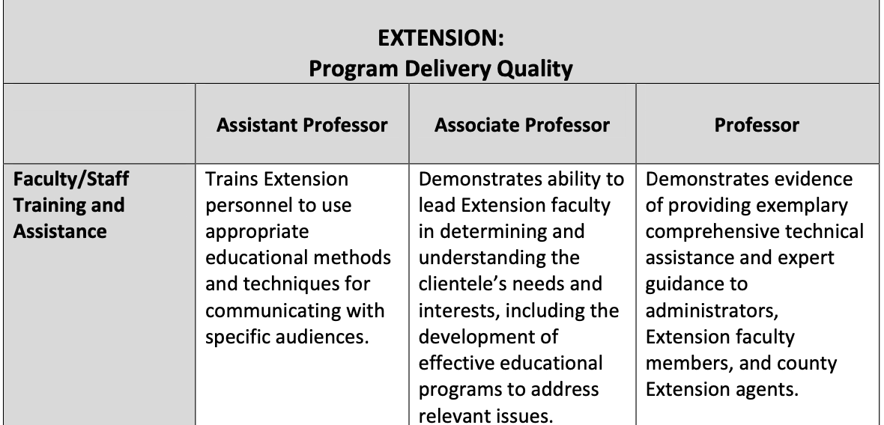

Slide 22
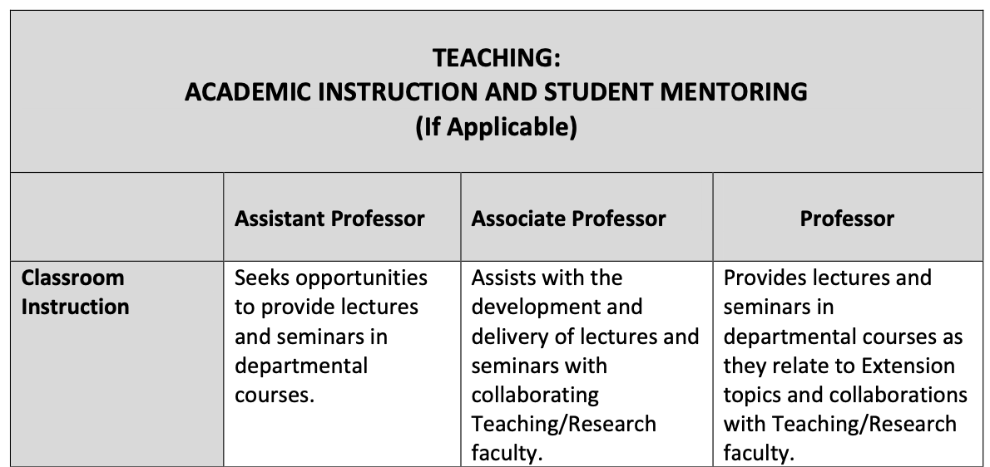

Slide 24
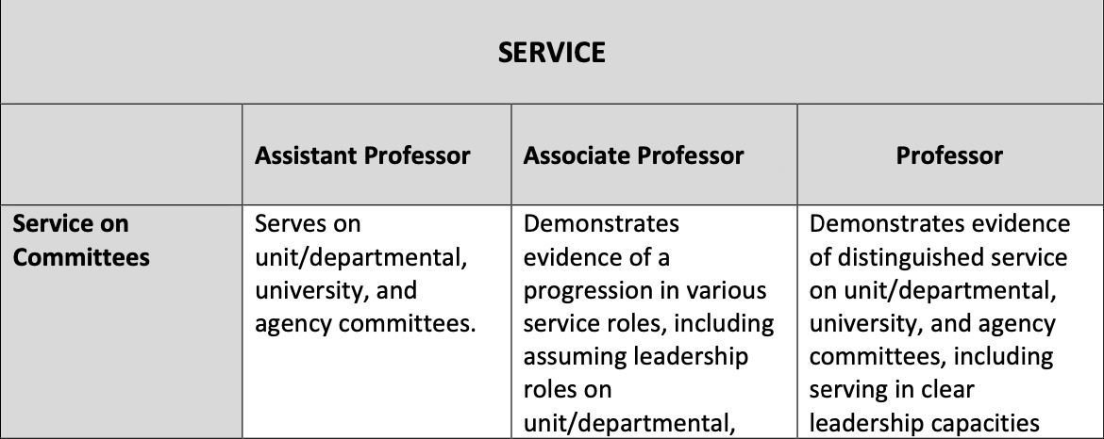

Slide 25
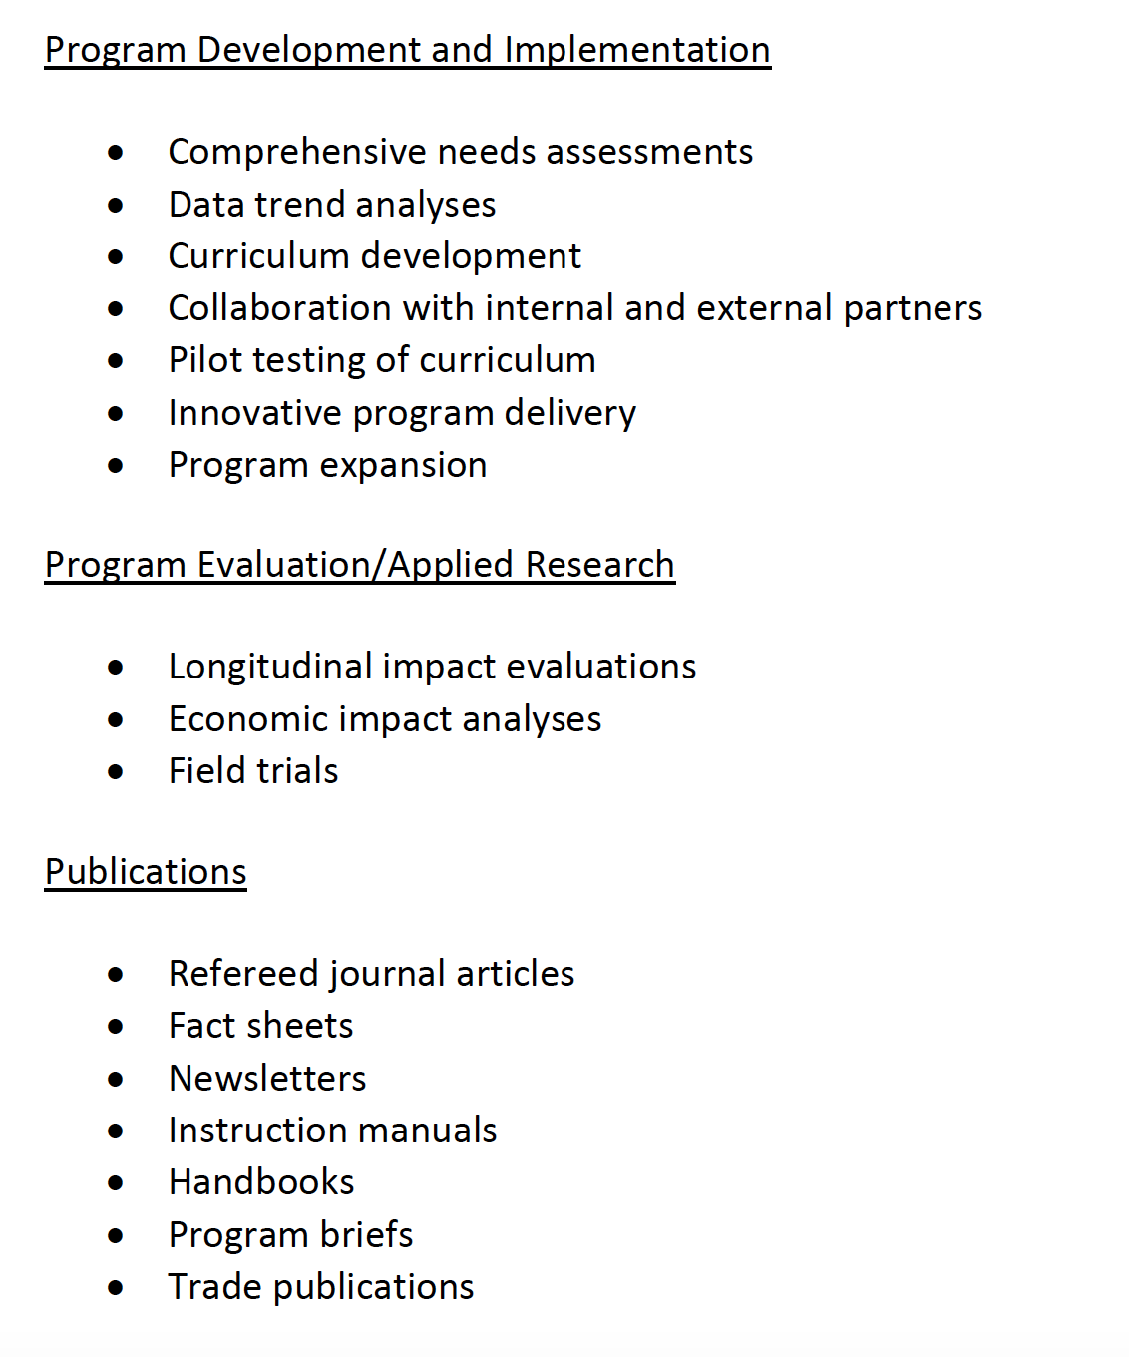
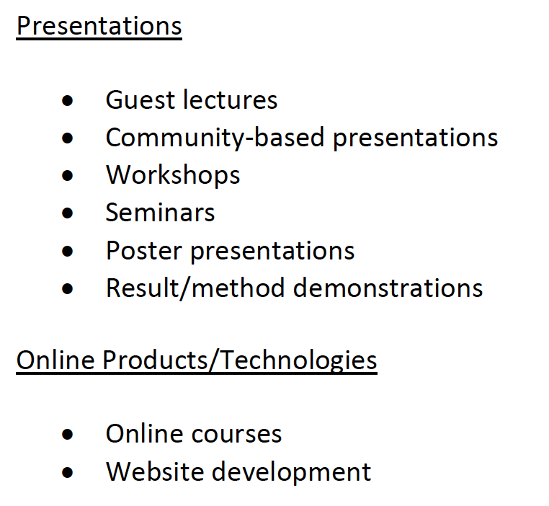
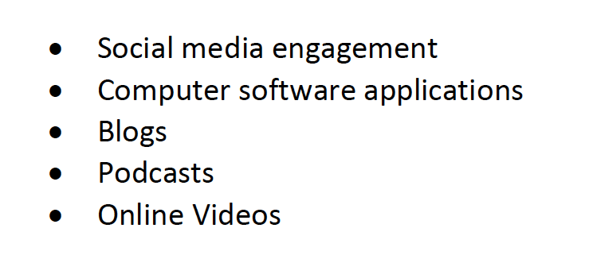
List of
Items to
Track

Slide 26
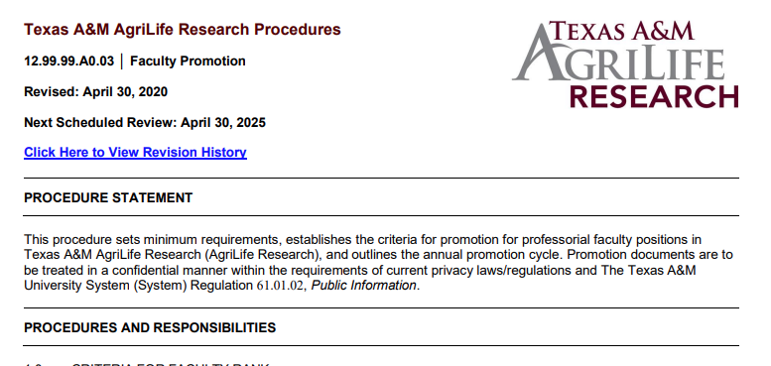
https://agrilifeas.tamu.edu/documents/129999a003.pdf/
Sections 1.0 – 3.2 only

Slide 27
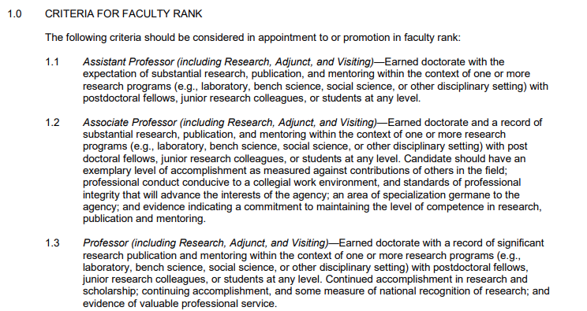
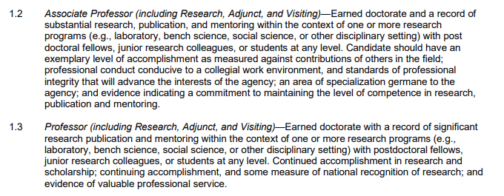
Within 5 years and prior to the 6th year…
After 6 years and prior to the 7th year…

Slide 29
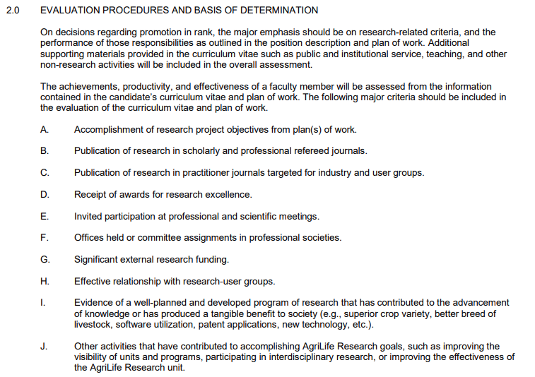

Slide 30
Research and Extension ad loc faculty with Academic Teaching Responsibilities
For Extension or Research Ad loc. faculty seeking promotion that have a minority teaching appointment or are teaching on an overload basis:
The Department Head will evaluate the teaching performance of the candidate using the processes described in the departmental Guidelines for Faculty Evaluation in the teaching category.
The Department Head will convey their assessment in the Department Head letter that is transmitted to the Agency Associate Director(s).
The candidate will not go through the College Promotion and Tenure processes and will not go through the Department P&T committee and the College Peer Review Committee. Instead, the candidate will follow the AgriLife Research and Extension Promotion Processes.
The Associate Director will consider the candidate’s teaching performance in their recommendation to the Director(s), in relation to their overall position description.
The Director(s) will confer with the College Executive Associate Dean before making a final decision regarding approval or denial of the promotion.

Slide 31
https://coalsfaculty.wpenginepowered.com/promotion-tenure/

Slide 32
Questions?

